Slide 1

AIR QUALITY INDEX
Ioana Platon
Scott Park-Vokoun
Brandon Umana
Ethan Devey

Slide 2

How Bad is the Air We Breathe
We wanted to see the air quality of various counties across the United States in 2024 ( over 1000 rows of data).
Using the Air Quality System(AQS) database found through the EPA to get Air Quality Index(AQI) Data.
The AQI data includes information on healthy days, unhealthy days, hazardous days, max AQI, media AQI, and more
This data can help users determine the air quality across the United States and the number of days with unhealthy air.

Slide 3
Our Process
Updated our CSV file to incorporate latitude and longitude using Nominatim.
Converted CSV to GeoJSON using GeoPandas and a little bit of help from ChatGPT.
We put our GeoJSON file into MongoDB to store the data and create a flask API.
We used VS Code and stored our raw data file in github so we could use it as an api for our project.
We created an HTML File, CSS File, and a few JavaScript files to create our maps and charts.
Used OpenStreetMap and Leaflet to create the map
https://vokouns.github.io/usa-aqi-map/

Slide 4
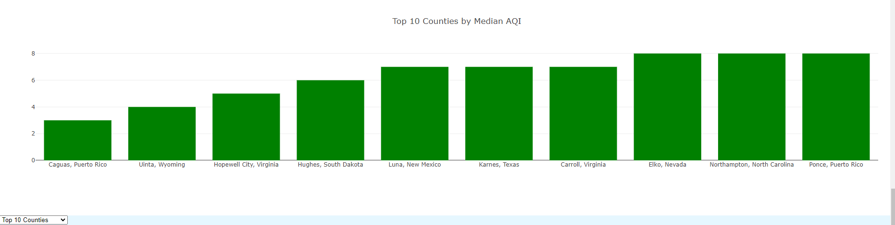
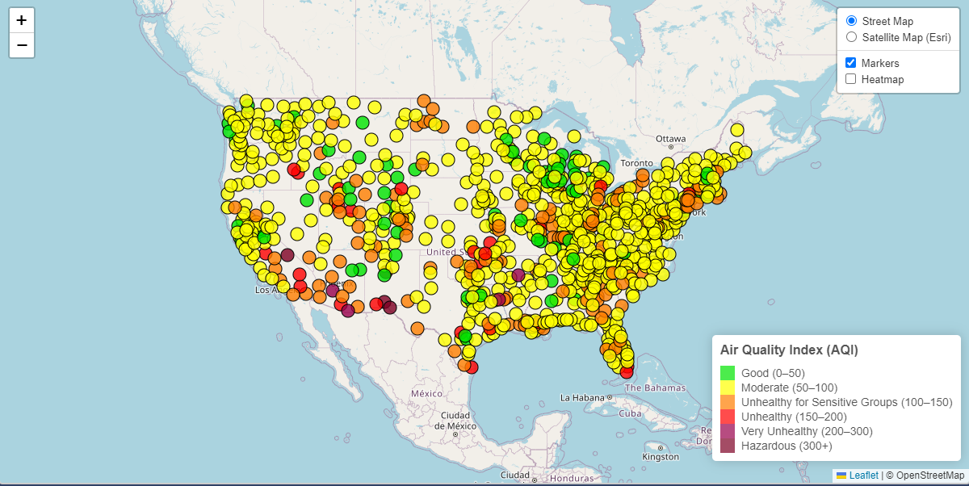
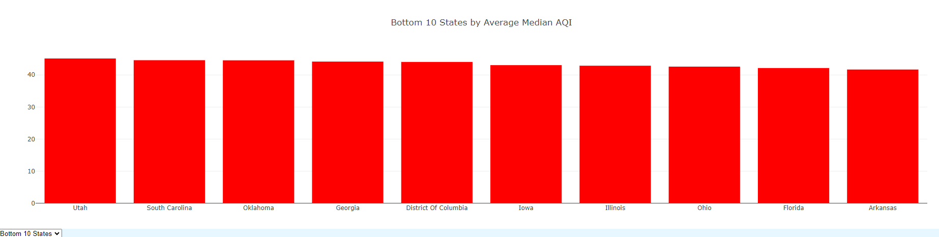
What our Data shows
Map Data shows the Max AQI by county to show the various levels of dangerous air across the United States
Organized data to show Top & Bottom 10 of Median AQI for both Counties and States.

